Slide 1





Stress Detection & Management System
Team ID - CU_CP_Team_10511
Team Members:
Zalak Doshi(IT)
Patel Shreya Rajnikant(IT)
Sohani Pangotra(IT)
Guided By:
Mr. Pranay Sharma
Notes:
Slide Duration: 5 min
Objective: To get an insight about Design Thinking
Procedure:
Explanation:
Introduce the topic "Design Thinking"
Design thinking is a creative approach to problem-solving that puts people at the center.
It starts with understanding the needs of those who will use what you're designing.
Then, it involves brainstorming ideas, prototyping solutions, and testing them to see what works best.
It's about being open-minded, collaborative, and willing to try new things to come up with innovative solutions that really fit people's needs.
Learning outcome: Students will be introduced to the topic Design Thinking.

Slide 2
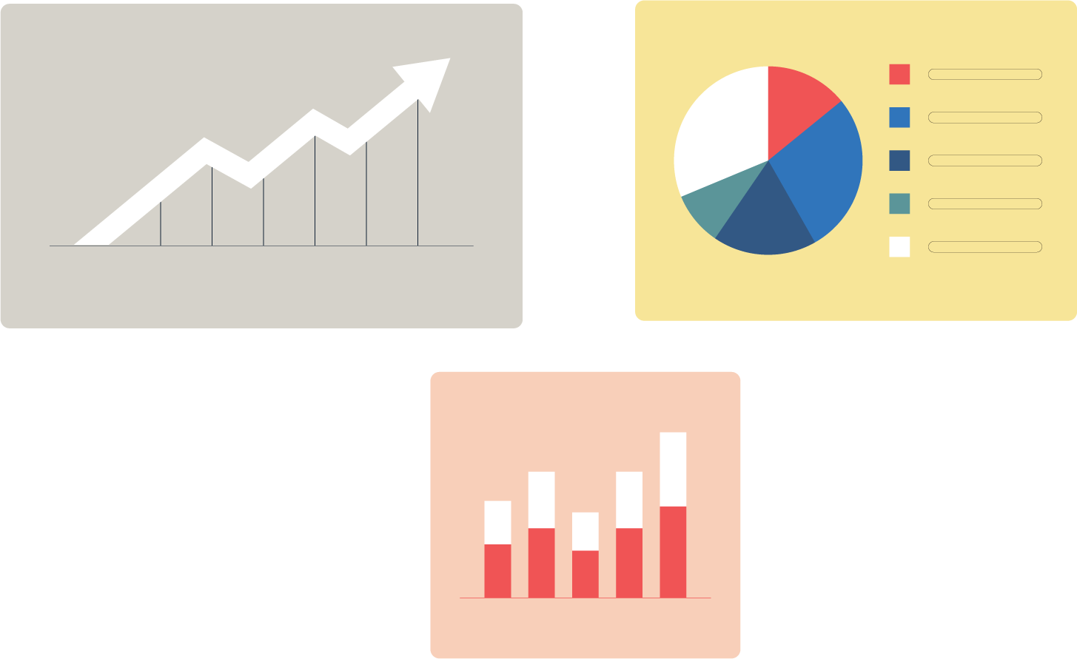

Project Objectives
Problem Statement
Project Overview – Introduction
Tech Stack
System Architecture
Modelling/Block Diagram/Flow of Project
API Endpoints
Github link & Conclusion
Future Perspective
Source
https://www.freepik.com/
Notes:
Slide duration: 5 min
Objective: To know the content of the lesson.
Procedure:
Tell students what they are going to learn today.
Discuss each topics given in the slide.
Learning Outcome: Students will get to know the content of today's lesson.

Slide 3
Problem Statement
Stress is a growing epidemic affecting millions worldwide, leading to mental health issues, decreased productivity, and physical health problems.
Lack of accessible tools for individuals to monitor and manage their stress levels effectively.
No personalized approach - generic stress management advice doesn't work for everyone.
Limited self-awareness - people often don't recognize stress triggers until it's too late.
Need for early intervention through continuous monitoring and AI-powered prediction.
Impact 77% of people experience stress affecting their physical health.
Stress-related issues cost organizations billions in lost productivity annually.
Early detection can significantly reduce long-term health consequences
Notes:
Total duration: 5mins
Learning Objective: In this slide, the trainer will explain the students what they will learn and be able to apply in the real life situations.
Procedure: Discuss the above as the outcome of the session
Learning outcome: Students will understand the learning outcome in this slide.

Slide 4
Project overview
Develop an AI-powered Stress Prediction System using Machine Learning algorithms to classify stress levels (Low/Medium/High).
Create a User-Friendly Web Interface for seamless stress assessment and tracking
Provide Personalized Recommendations based on individual stress levels and triggers
Enable Continuous Monitoring through mood journaling and historical analysis
Implement AI Chatbot Support for immediate stress relief assistance
Generate Comprehensive Reports (Weekly, Monthly, Before/After) to track progress
Notes:
Total duration: 5mins
Learning Objective: In this slide, the trainer will explain the students what they will learn and be able to apply in the real life situations.
Procedure: Discuss the above as the outcome of the session
Learning outcome: Students will understand the learning outcome in this slide.

Slide 5
Tech Stack
Frontend:
Technology Purpose
React.js User Interface Development
React Router Page Navigation
Recharts Data Visualization (Charts, Graphs)
Axios API Communication
CSS3 Modern, Responsive Styling
Backend:
Technology Purpose
Flask (Python) REST API Server
Flask-CORS Cross-Origin Resource Sharing
PyMongo MongoDB Database Driver
Werkzeug Password Hashing & Security
Joblib ML Model Serialization
Notes:
Total duration: 5mins
Learning Objective: In this slide, the trainer will explain the students what they will learn and be able to apply in the real life situations.
Procedure: Discuss the above as the outcome of the session
Learning outcome: Students will understand the learning outcome in this slide.

Slide 6
Tech Stack
Database:
Technology Purpose
MongoDB Atlas Cloud NoSQL Database
Machine Learning:
Technology Purpose
Scikit-learn ML Model Training
Pandas Data Processing
NumPy Numerical Computations
Notes:
Total duration: 5mins
Learning Objective: In this slide, the trainer will explain the students what they will learn and be able to apply in the real life situations.
Procedure: Discuss the above as the outcome of the session
Learning outcome: Students will understand the learning outcome in this slide.

Slide 7
System Architecture: Frontend: 1. App.js Main file that sets up page routing and checks if user is logged in. Uses: React Router, localStorage, Conditional Rendering. 2. Navbar.js Shows navigation menu with 6 links and logout button. Uses: NavLink, useNavigate, Array mapping. 3. Login.js Takes email and password, authenticates user, stores session in browser. Uses: useState, axios POST, localStorage. 4. Register.js Takes user details (name, email, password) and creates new account. Uses: useState, axios POST, Form handling. 5. Dashboard.js Shows overview with stat cards, line chart, pie chart, and progress tracking. Uses: useState, useEffect, axios GET, Recharts library.
Notes:
Total duration: 5mins
Learning Objective: In this slide, the trainer will explain the students what they will learn and be able to apply in the real life situations.
Procedure: Discuss the above as the outcome of the session
Learning outcome: Students will understand the learning outcome in this slide.

Slide 8
System Architecture: Frontend: 6. StressForm.js Collects 21 input fields, sends to ML model, displays prediction result with emoji. Uses: useState, axios POST, Form handling. 7. Recommendations.js Shows personalized stress relief tips based on user's stress level. Uses: useState, useEffect, axios GET. 8. Journal.js Lets user log daily mood with emoji selection and optional notes. Uses: useState, useEffect, axios GET and POST. 9. Reports.js Shows weekly/monthly reports with pie charts and before/after comparison. Uses: useState, useEffect, axios GET, Recharts library. 10. Chatbot.js Chat interface for AI stress support with quick reply buttons. Uses: useState, useRef, axios POST, Auto-scroll.
Notes:
Total duration: 5mins
Learning Objective: In this slide, the trainer will explain the students what they will learn and be able to apply in the real life situations.
Procedure: Discuss the above as the outcome of the session
Learning outcome: Students will understand the learning outcome in this slide.

Slide 9
System Architecture: Backend: 1. app_mongodb.py Main server file containing all 15+ REST API endpoints. Uses: Flask, CORS, PyMongo, Joblib. 2. stress_model.py Trains 3 ML models (Random Forest, SVM, Logistic Regression) and saves the best one. Uses: scikit-learn, Pandas, OneHotEncoder, StandardScaler. 3. /api/register endpoint Creates new user account with password hashing. Uses: UUID generation, Werkzeug password hashing, MongoDB insert. 4. /api/login endpoint Verifies email and password, returns user data. Uses: Password verification, MongoDB query. 5. /api/predict endpoint Preprocesses input data, runs ML model prediction, saves result to database. Uses: OneHotEncoder, StandardScaler, Random Forest model. 6. /api/recommendations endpoint Returns array of tips based on stress level (Low/Medium/High).
Notes:
Total duration: 5mins
Learning Objective: In this slide, the trainer will explain the students what they will learn and be able to apply in the real life situations.
Procedure: Discuss the above as the outcome of the session
Learning outcome: Students will understand the learning outcome in this slide.

Slide 10
System Architecture: 7. /api/journal endpoint GET: Fetches user's journal entries. POST: Saves new mood entry. Uses: MongoDB find and insert, Date handling. 8. /api/reports endpoint Calculates weekly/monthly statistics and stress level distribution. Uses: MongoDB queries, Date filtering, Percentage calculation. 9. /api/chat endpoint Matches keywords in user message and returns appropriate bot response. Uses: Keyword matching, Dictionary lookup. Database: 1. users collection Stores user accounts with user_id, name, email, and hashed password. 2. stress_history collection Stores all stress predictions with user_id, stress_level, and prediction_date. 3. mood_journal collection Stores daily mood entries with user_id, mood emoji, notes, and entry_date.
Notes:
Total duration: 5mins
Learning Objective: In this slide, the trainer will explain the students what they will learn and be able to apply in the real life situations.
Procedure: Discuss the above as the outcome of the session
Learning outcome: Students will understand the learning outcome in this slide.

Slide 11
Machine Learning Model
Dataset Information:
Total Samples: 774 records
Features: 22 input features
Target Variable: Stress Level (Low/Medium/High)
Feature Categories
Personal Age, Gender, Occupation, Marital StatusSleep
Sleep Duration, Sleep Quality, Wake Up Time, Bed Time
Lifestyle Physical Activity, Screen Time, Exercise Type, Meditation PracticeHabits
Caffeine Intake, Alcohol Intake, Smoking Habit Work
Work Hours, Travel Time
Health Blood Pressure, Cholesterol Level, Blood Sugar
Level Social Social InteractionsPreprocessing Pipeline
Notes:
Total duration: 5mins
Learning Objective: In this slide, the trainer will explain the students what they will learn and be able to apply in the real life situations.
Procedure: Discuss the above as the outcome of the session
Learning outcome: Students will understand the learning outcome in this slide.

Slide 12
Machine Learning Model
Feature Categories
Time Conversion Wake Up Time & Bed Time → Minutes
One-Hot Encoding Categorical variables (Gender, Occupation, etc.)
StandardScaler Numerical feature normalizationClass Balancing - Resampling for balanced classes
Notes:
Total duration: 5mins
Learning Objective: In this slide, the trainer will explain the students what they will learn and be able to apply in the real life situations.
Procedure: Discuss the above as the outcome of the session
Learning outcome: Students will understand the learning outcome in this slide.

Slide 13
ML Comparison
Algorithms Evaluated
Algorithm Accuracy Best For
Random Forest 72.9% Feature importance, robust predictions
Logistic Regression ~68% Baseline model, interpretability
Best Model Selected
Random Forest Classifier
Model Configuration
n_estimators = 100 (decision trees)
random_state = 42 (for reproducibility)
Why Random Forest?
Highest accuracy
Handles non-linear patterns
Notes:
Total duration: 5mins
Learning Objective: In this slide, the trainer will explain the students what they will learn and be able to apply in the real life situations.
Procedure: Discuss the above as the outcome of the session
Learning outcome: Students will understand the learning outcome in this slide.

Slide 14
Key Code Snippet models = { 'Logistic Regression': LogisticRegression(max_iter=1000), 'Random Forest': RandomForestClassifier(n_estimators=100, random_state=42), 'SVM': SVC(kernel='rbf', probability=True) } # Random Forest selected as best performing model
Notes:
Total duration: 5mins
Learning Objective: In this slide, the trainer will explain the students what they will learn and be able to apply in the real life situations.
Procedure: Discuss the above as the outcome of the session
Learning outcome: Students will understand the learning outcome in this slide.

Slide 15
API Endpoints
Authentication Endpoints:
Method Endpoint Description
POST /api/register Register new user
POST /api/login User login with password hash
Core Functionality Endpoints:
Method Endpoint Description
POST /api/predict ML-based stress level prediction
POST /api/analyze-triggers Identify stress triggers
POST /api/forecast Predict stress trends
Support Endpoints:
Method Endpoint Description
GET /api/recommendations/:level Personalized tips by level
Notes:
Total duration: 5mins
Learning Objective: In this slide, the trainer will explain the students what they will learn and be able to apply in the real life situations.
Procedure: Discuss the above as the outcome of the session
Learning outcome: Students will understand the learning outcome in this slide.

Slide 16

Github Link:
https://github.com/zalakdoshi/Stress_Management_System
Conclusion
Successfully developed an AI-based Stress Detection System
Built a full-stack web application
Implemented personalized stress management features
Enabled continuous stress monitoring
Created a user-friendly interface Demonstrated practical application of Machine Learning
Source
https://www.freepik.com/
Notes:
Slide duration: 5 min
Objective: To get clarity about the lesson is well received among students.
Procedure:
Ask: What did you learn from the lesson?
What is your takeaways from the lesson?
How this lesson is going to help you in your personal and professional life.
How are you going to implement this lesson?

Slide 17
Future Perspective
Make recommendations dynamic using AI instead of static pre-defined tips.
Integrate ChatGPT API for intelligent, conversational chatbot responses.
Connect with smartwatches for real-time heart rate and sleep data.
Develop mobile app with push notifications.
Improve ML accuracy using Deep Learning models.
Notes:
Total duration: 5mins
Learning Objective: In this slide, the trainer will explain the students what they will learn and be able to apply in the real life situations.
Procedure: Discuss the above as the outcome of the session
Learning outcome: Students will understand the learning outcome in this slide.

Slide 18
Thank You
Notes:
Time: 25 to 30 Sec

